Slide 1
Functions
What is a Function Expression?
A Function Expression defines a function as a part of a larger expression syntax (typically a variable assignment )

Slide 2
Example
The following example defines an unnamed function and assigns it to x. The function returns the square of its argument:
var x = function(y) {
return y * y;
};
More Info

Slide 3
Drawing Lines and Sprites

Slide 4
Info on Lines
https://developer.mozilla.org/en-US/docs/Web/API/Canvas_API/Tutorial/Applying_styles_and_colors

Slide 5
lineWidth example
The line width is the thickness of the stroke centered on the given path. In other words, the area that's drawn extends to half the line width on either side of the path. Because canvas coordinates do not directly reference pixels, special care must be taken to obtain crisp horizontal and vertical lines.

Slide 6
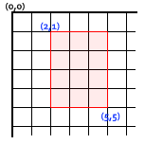
Obtaining crisp lines requires understanding how paths are stroked. In the image below, the grid represents the canvas coordinate grid. The squares between gridlines are actual on-screen pixels. In the grid image below, a rectangle from (2,1) to (5,5) is filled. The entire area between them (light red) falls on pixel boundaries, so the resulting filled rectangle will have crisp edges.

Slide 7
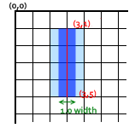
If you consider a path from (3,1) to (3,5) with a line thickness of 1.0, you end up with the situation below. The actual area to be filled (dark blue) only extends halfway into the pixels on either side of the path. An approximation of this has to be rendered, which means that those pixels being only partially shaded, and results in the entire area (the light blue and dark blue) being filled in with a color only half as dark as the actual stroke color. This is what happens with the 1.0 width line for a stroke.

Slide 8
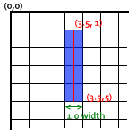
To fix this, you have to be very precise in your path creation. Knowing that a 1.0 width line will extend half a unit to either side of the path, creating the path from (3.5,1) to (3.5,5) results with a 1.0 line width completely and precisely filling a single pixel vertical line.

Slide 9
Example URL
var canvas = document.getElementById("myCanvas");
var canvasContext = canvas.getContext("2d");
canvasContext.beginPath();
for (var x = 0.5; x <= canvas.width; x += 25) {
canvasContext.moveTo(x, 0);
canvasContext.lineTo(x, canvas.height);
}
for (var y = 0.5; y <= canvas.height; y += 25) {
canvasContext.moveTo(0, y);
canvasContext.lineTo(canvas.width, y);
}
canvasContext.stroke();

Slide 10
Sprites
A sprite is a bitmap graphic that is designed to be part of a larger scene.

Slide 11
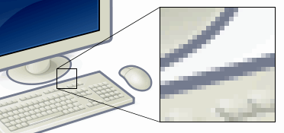
Bitmap
A bitmap (or raster graphic) is a digital image composed of a matrix of dots. When viewed at 100%, each dot corresponds to an individual pixel on a display. In a standard bitmap image, each dot can be assigned a different color. Together, these dots can be used to represent any type of rectangular picture.

Slide 12
Load the image
var balloonSprite = new Image();
balloonSprite.src = "spr_balloon.png";
Example URL

Slide 13
Game.drawImage
This is a special function written from the examples in the book. It will call drawImage on the context of the canvas in the HTML code.

Slide 14

Drawing the image
canvasContext.drawImage(ballonSprite, 50, 50);
This will draw the sprite at the x,y position.
You cannot call the drawImage() method before the image has loaded!
Animated Example
We will learn about detecting the loading of data in another class.

Slide 15
Canvas Transition
The translate() method remaps the (0,0) position on the canvas.
Note: When you call a method such as fillRect() after translate(), the value is added to the x- and y-coordinate values.
save() | Saves the state of the current context
restore() | Returns previously saved path state and attributes

Slide 16
Canvas state isn't what's drawn on it. It's a stack of properties which define the current state of the tools which are used to draw the next thing.
The state you save is the state which will dictate what coordinate-orientation, dimension-scale, color, etc, you use to draw the NEXT thing (and all things thereafter, until you change those values by hand).

Slide 17
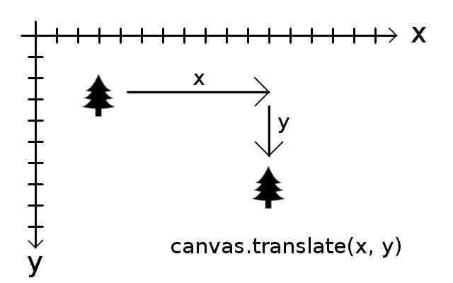
Translate just adds whatever numbers you put for x and y to the coordinates
of your canvas. In this example shifting it to the right and down.
If you want to move it left or up, just use negative numbers for x and y.

Slide 18
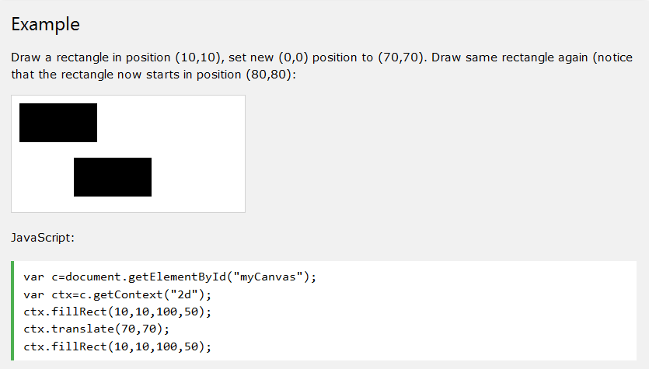
Canvas Transition – Example URL

Slide 19
drawImage Advanced Example
context.drawImage(img,sx,sy,swidth,sheight,x,y,width,height);
img | Specifies the image, canvas, or video element to use
sx | Optional. The x coordinate where to start clipping
sy | Optional. The y coordinate where to start clipping
swidth | Optional. The width of the clipped image
sheight | Optional. The height of the clipped image
x | The x coordinate where to place the image on the canvas
y | The y coordinate where to place the image on the canvas
width | Optional. The width of the image to use (stretch or reduce the image)
height | Optional. The height of the image to use (stretch or reduce the image)

Slide 20
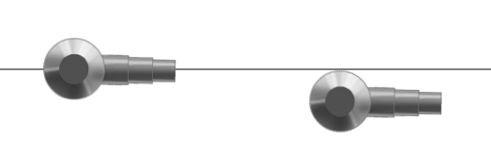
Origin
The origin of the image allows you to adjust were to place the image.
In both cases they are placed on the Y axis at 150 pixels. However the image on the left has an origin of -34,-34 to the position drawn. The image on the right has an origin of 0,0 (upper left pixel), which is why it is not centered on the line.
Examples: Still - Animated

Slide 21
HTML DOM Events
HTML DOM events allow JavaScript to register different event handlers on elements in an HTML document.
Events are normally used in combination with functions, and the function will not be executed before the event occurs (such as when a user clicks a button).
Such as:
document.onmousedown = handleMouseDown;
More info:
https://www.w3schools.com/jsref/dom_obj_event.asp
https://developer.mozilla.org/en-US/docs/Web/API/MouseEvent
https://developer.mozilla.org/en-US/docs/Web/API/KeyboardEvent

Slide 22
Move a sprite
Sprite at Center of Mouse Position

Slide 23
No Cursor
In the CSS:
.nocursor { cursor: none; }
In the HTML: <div id="gameArea" class="nocursor">
Example

Slide 24
Example drawing a sprite

Slide 25
Debugging
console.log
F12
NetBeans Debugger

Slide 26
JavaScript Arrays
https://www.w3schools.com/js/js_arrays.asp

Slide 27
JSON – For later use.
http://www.askyb.com/javascript/load-json-file-locally-by-js-without-jquery/
data = '[{"name" : "Harry", "age" : "32"}]';
function load() {
var mydata = JSON.parse(data);
alert(mydata[0].name);
alert(mydata[0].age);
}

Slide 28
JSON – For later use.
https://web.archive.org/web/20220525072144/http://www.askyb.com/javascript/load-json-file-locally-by-js-without-jquery/
data = '[{"name" : "Harry", "age" : "32"}]';
function load() {
var mydata = JSON.parse(data);
alert(mydata[0].name);
alert(mydata[0].age);
}

